Slide 1
File-Systems

Slide 2
File Attributes
Name – only information kept in human-readable form
Identifier – unique tag (number) identifies file within file system
Type – needed for systems that support different types
Location – pointer to file location on device
Size – current file size
Protection – controls who can do reading, writing, executing
Time, date, and user identification – data for protection, security, and usage monitoring
Information about files are kept in the directory structure, which is maintained on the disk
Many variations, including extended file attributes such as file checksum
Information kept in the directory structure

Slide 3
File Operations
Create
Write – at write pointer location
Read – at read pointer location
Reposition within file - seek
Delete
Truncate

Slide 4

File Types – Name, Extension

Slide 5
File Naming
When a process creates a file, it gives a file name
When the process terminates, the file continues to exist and can be accessed by other processes using its name.
Some file systems distinguish between upper and lower case letters, whereas others do not.
Are the file names cat.doc, cAt.doc, caT.doc and CAT.doc same in windows? What about in UNIX?

Slide 6
File Naming
Many OS support two-part file names- two parts separated with a period (.).
The part after the period is called file extension.
Filename extensions can be considered a type of metadata.
They are commonly used to infer information about the way data might be stored in the file.

Slide 7
File Structure
None - sequence of words, bytes
Simple record structure
  Lines
  Fixed length
  Variable length
Complex Structures
  Formatted document
Can simulate last two with first method by inserting appropriate control characters
Who decides:
  Operating system
  Program

Slide 8

Sequential-access File

Slide 9
Access Methods
Sequential Access
read next
write next
reset
Direct Access – file is fixed length logical records
read n
write n
position to n
read next
write next
rewrite n
n = relative block number
Relative block numbers allow OS to decide where file should be placed

Slide 10

Simulation of Sequential Access on Direct-access File

Slide 11
File System Layout
File systems are stored on disks
Disks are divided up into one or more partitions
Each partition has independent file systems
Sector 0 of the disk is called Master Boot Record (MBR)
Computer uses MBR to boot itself
The end of MBR contains the partition table- that has the start and end address of each partition

Slide 12
File System Layout
One of the partitions in the partition table is marked as active
When computer is booted, the BIOS reads in and executes MBR
The first thing MBR program does is to locate the active partition
The first block of this active partition is Boot Block.
MBR reads and executes it.
The program in Boot Block loads the OS contained in that partition

Slide 13
File System Layout
Every partition starts with a Boot Block
But only the partition having the OS will be marked as active
Other partitions hold the Boot Block as you can change your mind and copy another version of the OS into one of them

Slide 14
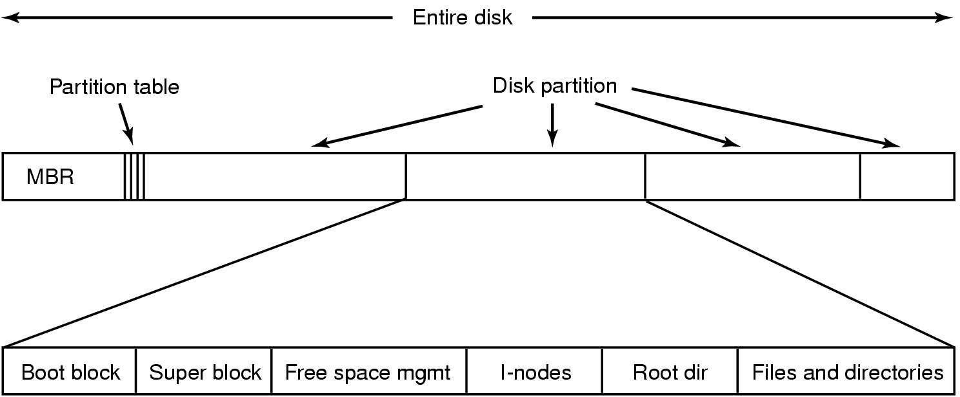
File System Layout

Slide 15
File System Layout
Super Block contains all the key parameters about the file system
It is read into memory when the computer is booted or the file system is first touched
Typically holds a Magic Number to identify the file system type (.exe or .bmp?), number of blocks, etc

Slide 16
File System Layout
Free space management reveals the free blocks in the file system
i-nodes is an array of data structures, one per file, simply telling about the file
Root directory contains the top of the file system tree
Remainder of the disk contains all other directory and files for that partition

Slide 17
Implementing Files:
Contiguous Allocation
Simplest allocation scheme to store each file as a contiguous run of disk blocks
Disk with 1 KB blocks, a 50 KB file would need 50 consecutive blocks; Disk with 2 KB blocks would make it okay with 25 consecutive blocks

Slide 18

Implementing Files:
Contiguous Allocation

Slide 19
Implementing Files:
Contiguous Allocation
Advantages
  Simple to implement ☺
  You only need to know the disk address of the first block and the distance of the file block from it
  Read performance is excellent, as you need only two seek operations (boot block and file block) and one read operation (one contiguous stream of bytes)
Disadvantages
  Disks become fragmented
  Wastage of storage is possible

Slide 20
Implementing Files:
Linked List Allocation
Every block will have two sections- a pointer to next one (the first word of the block) and data (the rest of the words)
Unlike contiguous allocation, every disk block can be used in this method
No space is lost due to disk fragmentation

Slide 21
Implementing Files:
Linked List Allocation
Reading a file sequentially is straight forward but random access is slow.
To get block n, the OS has to start at the beginning and read the n-1 blocks prior to it
Overhead due to pointer information

Slide 22

Implementing Files:
Linked List Allocation

Slide 23
Linked List Allocation: using Table in Memory
The disadvantages are eliminated by taking the pointer word from each block and putting it into a table in memory
Such a table in main memory is called FAT (File Allocation Table)

Slide 24
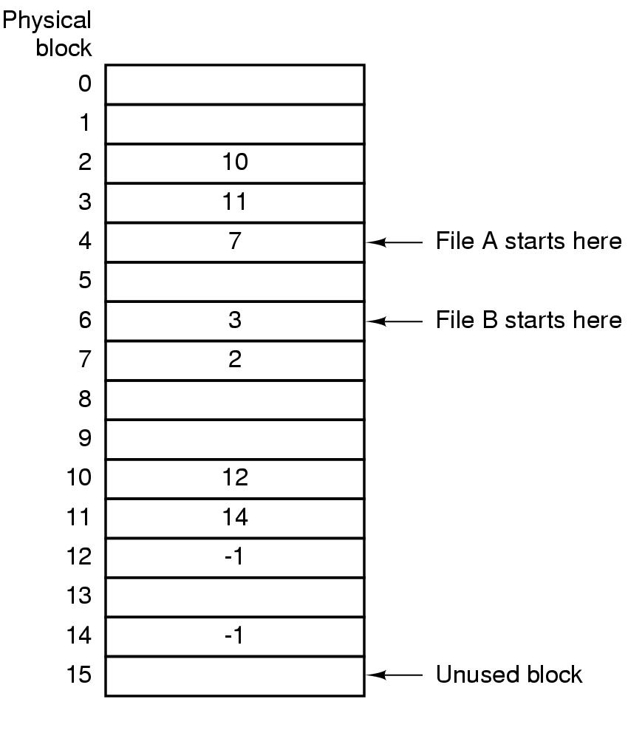
Linked List Allocation: using Table in Memory

Slide 25
Linked List Allocation: using Table in Memory
Entire block is available for data (no pointer information)
Faster random access
The primary disadvantage-
  the table must be in memory all the time to make it work
  a 20 GB disk and with 1 KB block size, the table needs 20 million entries one for each of 20 million blocks
  each entry is 4 bytes long so, FAT will occupy 80 MB space in memory all the time

Slide 26
i-nodes
It is a data structure that lists the attributes and disk addresses of the file’s blocks
With i-nodes, it is possible to find all the blocks of a file
i-nodes need only be in memory when the corresponding file is open
If each i-node contains n-bytes and there are k-files are opened at a time, that instant, kn-bytes are reserved in memory

Slide 27
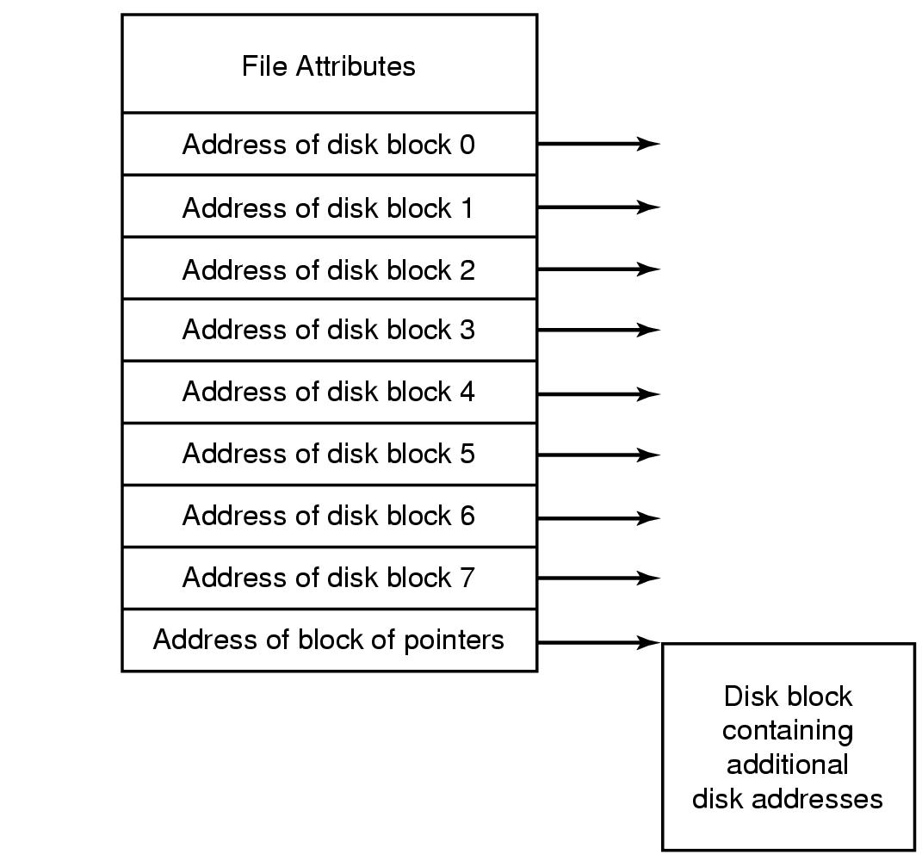
i-nodes

Slide 28
i-nodes
This array is usually far smaller than the space occupied by the FAT
Table for holding the linked list is proportional to disk itself.
If the disk has n blocks, the table needs n-entries
As the disks grow, the table grows linearly with them
i-node requires an array whose size is proportional to the maximum number of files that may be open at once (it does not matter if you have 1 petabyte HDD ☺)

Slide 29
i-nodes
The disadvantage is if you fix the size of i-node and your files have a tendency to grow larger (obviously you cannot say your file will be always 6MB in size ☺)

Slide 30
Directory Structure
A collection of nodes containing information about all files
Directory
Files
F 1
F 2
F 3
F 4
F n
Both the directory structure and the files reside on disk

Slide 31
Directory Organization
The directory is organized logically to obtain
Efficiency – locating a file quickly
Naming – convenient to users
  Two users can have same name for different files
  The same file can have several different names
Grouping – logical grouping of files by properties, (e.g., all Java programs, all games, …)

Slide 32

Single-Level Directory
A single directory for all users
Naming problem
Grouping problem

Slide 33

Two-Level Directory
Separate directory for each user
Path name
Can have the same file name for different user
Efficient searching

Slide 34

Tree-Structured Directories

Slide 35
Tree-Structured Directories
Efficient searching
Grouping Capability
Current directory (working directory)
  cd /spell/mail/prog

Slide 36

Tree-Structured Directories
Creating a new file is done in current directory
Delete a file
rm <file-name>
Creating a new subdirectory is done in current directory
  mkdir <dir-name>
  Example: if in current directory /mail
  mkdir count
Deleting “mail” ⇒ deleting the entire subtree rooted by “mail”

Slide 37
File Sharing
Sharing of files on multi-user systems is desirable
Sharing may be done through a protection scheme
On distributed systems, files may be shared across a network
Network File System (NFS) is a common distributed file-sharing method
If multi-user system
  User IDs identify users, allowing permissions and protections to be per-user
  Group IDs allow users to be in groups, permitting group access rights
  Owner of a file / directory
  Group of a file / directory

Slide 38
File Sharing – Remote File Systems
Uses networking to allow file system access between systems
  Manually via programs like FTP
  Automatically, seamlessly using distributed file systems
  Semi automatically via the world wide web
Client-server model allows clients to mount remote file systems from servers
  Server can serve multiple clients
  Client and user-on-client identification is insecure or complicated

Slide 39
Protection
File owner/creator should be able to control:
  what can be done
  by whom
Types of access
  Read
  Write
  Execute
  Append
  Delete
  List

Slide 40

Access Lists and Groups
Mode of access: read, write, execute
Three classes of users on Unix / Linux
RWX
a) owner access 7 ⇒ 1 1 1
RWX
b) group access 6 ⇒ 1 1 0
RWX
c) public access 1 ⇒ 0 0 1
Ask manager to create a group (unique name), say G, and add some users to the group.
For a particular file (say game) or subdirectory, define an appropriate access.
Attach a group to a file
chgrp G game

Slide 41

Windows 7 Access-Control List Management

Slide 42

A Sample UNIX Directory Listing

Slide 43
DFS
A file System where servers, clients and storage devices are dispersed among the machines of a distributed System.

Slide 44
What constitutes a DFS?
Service
  Software running on machine(s) providing particular services to clients
Server
  Service software running on a single machine
Client
  Process that can invoke a service using a set of operations that forms it’s client interface

Slide 45
Remote-Service Mechanism
Request for the service is delivered to the server
Server performs the Access
And finally results are forwarded back to user.
Practical Implementation is through RPC (Remote Procedure Call)
Major Problem is disk access for each request.
Get rid of the problem through applying Caching.

Slide 46
Basic caching Scheme
Data are cached to local machine
If data needed are absent in cache , a copy from server is brought to the client system
Access are performed in Cached Copy
No direct correspondence exists between accesses and traffic to the server.
The problem of keeping the cached copies consistence with the master copy is cache coherence/consistency problem

Slide 47
Basic caching Scheme
Disk Caches are reliable over volatile memory
Main memory cache too have some advantages :
  Permit workstations to be diskless
  Data access is more quick .
  Current technology support main memory Cache through high performance and cost effectiveness.

Slide 48
Cache Update Policy
Write Through Policy
  Reliable
  Write to disk as soon they are placed on any cache.
Delayed Write Policy
  Delayed for further modification
  Last update need to be written

Slide 49
Consistency
Client Initiated Approach
  Client initiates a validity check
Server initiated Approach
  Server records files that is being cached
  Must react when detects any inconsistency

Slide 50
Trade off between
Caching and Remote Services
Server load, network Traffic and performance penalty in remote service
Total network overhead less in caching
Cache consistency is a major problem in Caching

